Slide 1
Module 5: Adding a Database Layer
AWS Academy Cloud Architecting
© 2020, Amazon Web Services, Inc. or its Affiliates. All rights reserved.
Notes:
Welcome to Module 5: Adding a Database Layer.

Slide 2

Module overview
Sections
Architectural need
Database layer considerations
Amazon RDS
Amazon DynamoDB
Database security controls
Migrating data into AWS databases
Demonstration
Amazon RDS Automated Backup and Read Replicas
Labs
Guided Lab: Creating an Amazon RDS Database
Challenge Lab: Migrating a Database to Amazon RDS
Knowledge check
Notes:
This module includes the following sections:
Architectural need
Database layer considerations
Amazon RDS
Amazon DynamoDB
Database security controls
Migrating data into AWS databases
This module also includes:
A demonstration of Amazon Relational Database Service (Amazon RDS) automated backup and read replica configuration.
A guided lab where you create an Amazon RDS database and connect to it by using a simple web application.
A challenge lab that challenges you to migrate data from a database that runs on an Amazon Elastic Compute Cloud (Amazon EC2) instance to an Amazon RDS database.
Finally, you will be asked to complete a knowledge check to test your understanding of the key concepts that are covered in this module.

Slide 3
Module objectives
At the end of this module, you should be able to:
Compare database types
Differentiate between managed versus unmanaged services
Explain when to use Amazon Relational Database Service (Amazon RDS)
Explain when to use Amazon DynamoDB
Describe available database security controls
Describe how to migrate data into Amazon Web Services (AWS) databases
Deploy a database server
Notes:
At the end of this module, you should be able to:
Compare database types
Differentiate between managed versus unmanaged services
Explain when to use Amazon Relational Database Service (Amazon RDS)
Explain when to use Amazon DynamoDB
Describe available database security controls
Describe how to migrate data into Amazon Web Services (AWS) databases
Deploy a database server

Slide 4
Section 1: Architectural need
Module 5: Adding a Database Layer
Notes:
Introducing Section 1: Architectural need.

Slide 5









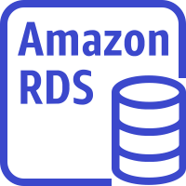










Databases as part of a larger architecture
Region
VPC
v
Public subnet
Private subnet
Private subnet
Amazon
CloudFront
Availability Zone 2
NAT gateway
EC2 instances
ElastiCache for Memcached
Amazon RDS standby instance
Amazon EFS mount target
Internet gateway
v
Application
Load Balancer
Amazon EC2 Auto Scaling
Amazon EFS
Amazon Route 53
Public subnet
Private subnet
Private subnet
Availability Zone 1
NAT gateway
EC2 instance
ElastiCache for Memcached
Amazon RDS primary instance
Amazon EFS mount target
Users
Static website on S3
Notes:
As each module introduces new features, those parts of this larger diagram will be unveiled. In this module, you will learn how to create an architecture that uses AWS database services. Different relational and non-relational database service options—including Amazon RDS—are discussed. As you learn about the essential benefits of the various offerings, you will be able to make a more informed decision about the database service that best meets your particular architectural needs.

Slide 6
Café business requirement
The café needs a database solution that is easier to maintain, and that provides essential features such as durability, scalability, and high performance.
Notes:
Ever since the cafe added the ability to place online orders to their website, the café staff have noticed that business has increased. In addition, they discovered that the order history that’s stored in the database—which they installed on the same EC2 instance where the web server is running—provides valuable business information. Martha uses it for accounting purposes, and Frank looks at it occasionally to get an idea of how many of each dessert type he should bake. However, Sofía has some concerns. The database needs to be upgraded and patched, and she doesn’t always have time to do these tasks on a regular basis. Also, administering the database is a specialized skill, and training others to do it isn’t something she wants to spend time on. Meanwhile, she is also concerned that the cafe isn’t doing data backups as often as they should. The café staff wants to reduce the labor costs associated with the technical learning investment that’s needed to manage the database themselves. Thus, they decided that they need to use a managed database solution. Ideally, they will find one that provides essential features, such as durability, scalability, and high performance. Throughout this module, you will learn details about the different database services that AWS provides, and the capabilities that are provided by these different services. With this understanding of the available options, you should be able to choose a database solution that can successfully meet these new business requirements.

Slide 7
Section 2: Database layer considerations
Module 5: Adding a Database Layer
Notes:
Introducing Section 2: Database layer considerations.

Slide 8

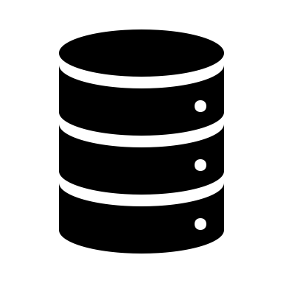


Database considerations: Scalability
Scalability
How much throughput is needed?
Will the chosen solution be able to scale up later, if needed?
Total storage requirements
Object size and type
Durability
Notes:
As an architect, you will often need to choose between different database types when you consider which type will best handle a particular workload. Before you choose a database, there are some key considerations that should inform your decision-making process.
First, consider the importance of scalability. With traditional on-premises databases, scaling up capacity can be a difficult task even for experienced database administrators. It can take hours, days, or weeks. The impact to database performance while it scales up can be unpredictable, and might require downtime. However, the importance of a properly scaled database cannot be overstated. If you underprovision your database, your applications might stop working. However, if you overprovision your database, you increase your upfront costs by procuring resources that you do not need, which violates the cost-optimization principle of the AWS Well-Architected Framework.
Ideally, you would choose a database solution that has the resources to handle the needed throughput at launch, and that can also be easily scaled up later if your throughput needs increase.
Another nice-to-have capability is the ability to scale down the provisioned database capacity if your throughput requirements or database load later decrease. This enables you to immediately realize cost savings by lowering provisioned capacity. An automated scaling solution could reduce costs and labor overhead.

Slide 9
Database considerations: Storage requirements
Scalability
How large does the database need to be?
Will it need to store GB, TB, or petabytes of data?
Total storage requirements
Object size and type
Durability
Notes:
Second, when you must choose a database to handle a certain type of workload, consider the storage requirements of your workload.
How large must the database be to handle your data requirements? Does it need to store gigabytes? Terabytes? Petabytes?
Different database architectures support different maximum data capacities. Some database designs are ideal for traditional applications, while others are ideal for caching or session management. Still others are ideal for Internet of Things (IoT) or big data applications.
Understanding your total storage requirements is essential for choosing a database.

Slide 10
Database considerations: Object size and type
Scalability
Do you need to store simple data structures, large data objects, or both?
Total storage requirements
Object size and type
Durability
Notes:
Third, when you choose a database for your specific workloads, consider the size and the type of the objects you must store.
Do you need to store simple data structures, large data objects, or both?

Slide 11
Database considerations: Durability
Scalability
What level of data durability, data availability, and recoverability is required?
Do regulatory obligations apply?
Total storage requirements
Object size and type
Durability
Notes:
Finally, as a fourth consideration for your database choice, think about the durability requirements for the data you will store.
Data durability refers to the assurance that your data will not be lost, and data availability refers to your ability to access your data when you want to. What level of data durability and data availability do you need? If the data you will store is absolutely critical to your business, you should choose a database solution that stores multiple redundant copies of your data across multiple geographically separated physical locations. This solution will usually result in an increased cost, so it is important to balance your business needs with cost considerations.
Another important consideration is to know whether data residency or regulatory obligations apply to your data. For example, are there regional data privacy laws that you must comply with? If so, choose a database solution that can support compliance.

Slide 12
Database types
Now that you reviewed key considerations, consider the two categories of database options available:
Traditional examples:
Relational
Non-Relational
Traditional examples:
Microsoft SQL Server
Oracle Database
MySQL
MongoDB
Cassandra
Redis
Notes:
You can choose from many types of databases, many of which are purpose-built. However, database types typically fall into one of two broad categories: relational or non-relational.
Relational database systems are the most familiar type of databases to most people. Traditional examples include Microsoft SQL Server, Oracle Database, and MySQL.
Non-relational databases were developed more recently, but have been around for a few decades. They play an essential role in the modern computing landscape. Examples include MongoDB, Cassandra, and Redis.

Slide 13
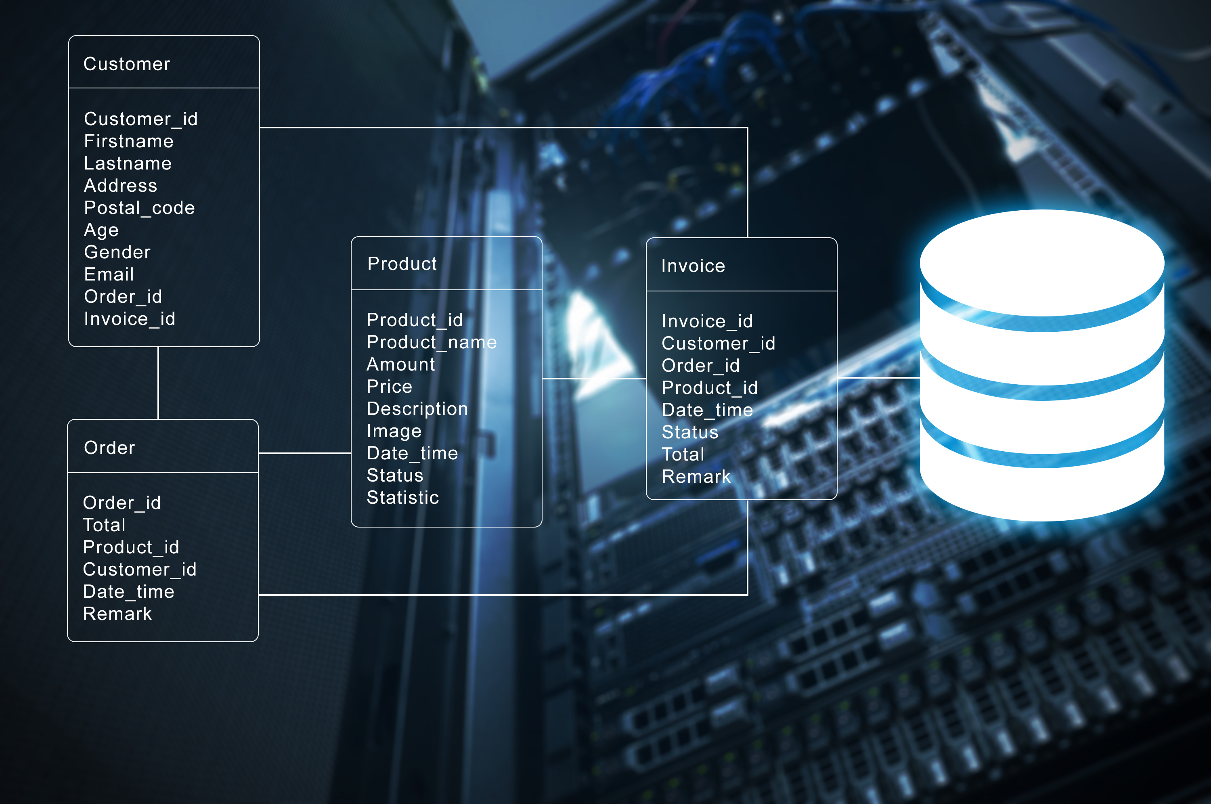


Relational database type
Benefits:
Ease of use
Data integrity
Reduced data storage
Common language (structured query language, or SQL)
Relational is ideal when you:
Need strict schema rules, ACID compliance, and data quality enforcement
Do not need extreme read/write capacity
Do not need extreme performance
An RDBMS can be the best, lowest-effort solution
SQL query
Response
Application server
User
Relational database management system (RDBMS)
Notes:
Relational databases are sometimes referred to as relational database management system (RDBMS). They are still the single most-popular and most-used database category in the world. In a 2019 DB-Engines Ranking study, they were found to represent over 75 percent of the popularity score across all categories. The top four were Oracle, MySQL, Microsoft SQL Server, and PostgreSQL—which are all relational databases.
Relational databases maintain their popularity for many reasons. These reasons include their ease of use, data integrity controls, excellence at reducing overall data storage, and their support for structured query language (SQL). SQL is a popular language for querying or interacting with structured data stored in RDBMSs, and it is supported by most vendors.
If your use case lends itself well to strict schema rules, where the schema structure is well defined and does not need to change often, a relational database would be a good choice. Relational databases transactions are also ACID-compliant, which means that they ensure data integrity by providing transactions that are atomic, consistent, isolated, and durable. However, if your application needs extreme read/write capacity, a relational database might not be the right choice. Finally, extreme performance is a characteristic of relational databases when you compare them to other options. However, a relational database can be the best low-effort solution for many use cases.

Slide 14
Non-relational database type
Benefits
Flexibility
Scalability
High performance
Highly functional APIs
Non-relational is ideal when:
Database must scale horizontally to handle massive data volume
Data does not lend itself well to traditional schemas
Read/write rates exceed what can be economically supported through traditional RDBMS
key-value
graph
key 1
value 1
Example models
key 2
value 2
key 3
value 3
Notes:
Non-relational databases are sometimes called NoSQL databases. They are different from relational databases because they are purpose-built for specific data models and have flexible schemas for building modern applications. Non-relational databases are widely appreciated for their flexibility, scalability, high performance, and highly functional APIs.
They use a variety of data models, including key-value, graph, document, in-memory, and search. NoSQL schemas are dynamic. For example, a row does not need to contain data for each column. Also, a NoSQL database can scale horizontally by increasing the number of servers that it runs on.
Non-relational databases have flexible schemas, where each object can have a different structure. They can store structured data, such as relational database records; semistructured data, such as JavaScript Object Notation (JSON) documents; and unstructured data, such as photo files or email messages. Non-relational databases work well when the data might have structural inconsistencies.
Finally, non-relational databases are optimized for specific data models and access patterns that enable higher performance instead of trying to achieve the functionality of relational databases.

Slide 15
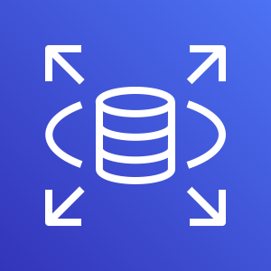

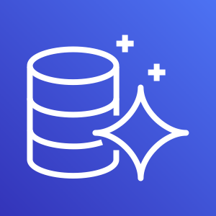
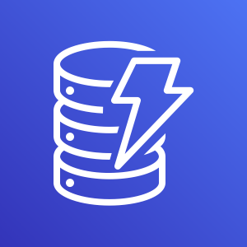
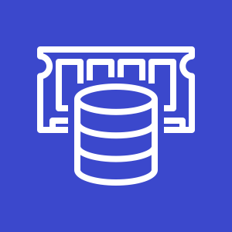
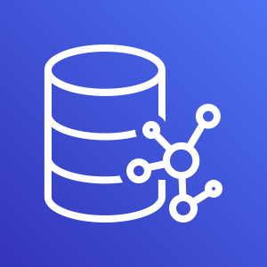
Amazon database options
More database options exist—these options are common examples
Relational databases
Non-relational databases
Amazon RDS
Amazon Redshift
Amazon Aurora
Amazon DynamoDB
Amazon ElastiCache
Amazon Neptune
Focus in this module
Notes:
Now that you learned about the distinctions between relational and non-relational database, consider some example Amazon database offerings that fit into those two categories.
Among the more commonly used AWS relational database offerings are Amazon RDS, Amazon Redshift, and Amazon Aurora.
Similarly, some of the more commonly used non-relational databases are Amazon DynamoDB, Amazon ElastiCache, and Amazon Neptune.
In this module, you will explore both Amazon RDS and Amazon DynamoDB in more depth. For a full listing of database services that are available on AWS and their most common uses cases, see the AWS Databases – Overview page.

Slide 16

Section 2 key takeaways
When you choose a database, consider scalability, storage requirements, the type and size of objects to be stored, and durability requirements
Relational databases have strict schema rules, provide data integrity, and support SQL
Non-relational databases scale horizontally, provide higher scalability and flexibility, and work well for semistructured and unstructured data
Notes:
Some key takeaways from this section of the module include:
When you choose a database, consider scalability, storage requirements, the type and size of objects to be stored, and durability requirements
Relational databases have strict schema rules, provide data integrity, and support SQL
Non-relational databases scale horizontally, provide higher scalability and flexibility, and work well for semistructured and unstructured data

Slide 17
Section 3: Amazon RDS
Module 5: Adding a Database Layer
Notes:
Introducing Section 3: Amazon RDS.

Slide 18

Amazon RDS
Relational
Amazon RDS is a fully managed relational database service.
Amazon RDS
Notes:
Amazon RDS is a fully managed relational database service that creates and operates a relational database in the cloud. However, before you learn more details about Amazon RDS, you will first review the advantages of Amazon RDS as a managed database service.

Slide 19
Advantage of managed AWS database services
You manage
App optimization
App optimization
App optimization
Scaling
Scaling
Scaling
High availability
High availability
High availability
Database backups
You manage
Database backups
Database backups
DB s/w patches
DB s/w patches
DB s/w patches
You manage
DB s/w installs
DB s/w installs
DB s/w installs
AWS manages
OS patches
OS patches
OS patches
OS installation
OS installation
OS installation
Server maintenance
AWS manages
Server maintenance
Server maintenance
Rack and stack
Rack and stack
Rack and stack
Power, HVAC, net
Power, HVAC, net
Power, HVAC, net
Host database on-premises
Host database in Amazon EC2
Host database in a managed AWS database service
Notes:
You will now consider some of the advantages of using managed AWS database services.
In the use case on the left, you host the database in your on-premises data center. In this case, you are responsible for everything. You must power the racks of physical servers, maintain the operating systems of the servers where the databases run, and performing database software installations and patches. You must also perform backups, configure high availability and scaling solutions, and optimize the applications that use the database.
In the center use case, you install a database on one or more Amazon EC2 instances. In this case, AWS handles the maintenance of the physical data center environment and the OS is pre-installed on the EC2 instance that you launch. However, you are still responsible for every configuration layer above the OS installation, which means that you must manage many resources manually.
The AWS managed database offering is in the use case on the right. These solutions provide high availability, scalability, and database backups as built-in options that you can configure. AWS is responsible for handling common and repetitive database administration tasks. You are only responsible for optimizing your application, and making sure that the database layer works efficiently for your application.

Slide 20



Amazon RDS characteristics
Access pattern
Data size
Performance
Business use cases
Transactional
Light analytics
Low-TB range
Mid to high throughput
Low latency
Transactional
OLAP
Notes:
Amazon Relational Database Service (Amazon RDS) is a fully managed relational database service.
Amazon RDS is typically used when the access pattern is transactional, or for light analytics.
As a relational database, the ideal data size ranges up to the low-terabyte range. As storage requirements grow, you can provision additional storage. The Amazon Aurora engine will automatically grow the size of your database volume as your database storage needs grow. It scales up to a maximum of 64 TB, or a maximum you define. The MySQL, MariaDB, Oracle, and PostgreSQL engines enable you to scale up to 32 TB of storage. Microsoft SQL Server supports up to 16 TB. Storage scaling is dynamic, with zero downtime.
In terms of performance, Amazon RDS offers two options. First, it offers the general-purpose solid state drive (SSD)-backed storage option. The SSD option delivers a consistent baseline of 3 IOPS per provisioned GB, and it can burst up to 3,000 IOPS above the baseline. This storage type is suitable for a range of database workloads. There is also a Provisioned IOPS SSD storage option, which works well for I/O-intensive transactional database workloads.

Slide 21

Amazon RDS: Uses and database types
Works well for applications that:
Have more complex data
Need to combine and join datasets
Need enforced syntax rules
Six database types supported:
Amazon RDS
Microsoft SQL Server
Oracle
MySQL
PostgreSQL
Aurora
MariaDB
Notes:
As a relational database offering, Amazon RDS is a good choice for applications that have complex, well-structured data. Amazon RDS is a good choice if your workloads must frequently combine and join datasets, and must have syntax rules that are strictly enforced. For example, Amazon RDS is frequently used to back traditional applications, enterprise resource planning (ERP) applications, customer relationship management (CRM) applications, and ecommerce applications.
Amazon RDS is available with six database engines to choose from, including Microsoft SQL Server, Oracle, MySQL, PostgreSQL, Amazon Aurora, and MariaDB.

Slide 22
Database instance sizing
T family
M family
R family
Type
Burstable instances
General-purpose instances
Memory-optimized instances
Sizing
1 vCPU/1 GB RAM to 8 vCPU 32 GB RAM
2 vCPU/8 GB RAM to 96 vCPU 384 GB RAM
2 vCPU/16 GB RAM to 96 vCPU 768 GB RAM
Networking
Moderate performance
High performance
High performance
Ideal Workload
Smaller or variable
CPU-intensive
Query-intensive, high connection counts
Highlights
T3 can burst above baseline for extra charge
M5 offers up to 96 vCPU
R5 offers up to 96 vCPU 768 GiB RAM
Notes:
All Amazon RDS database types run on a serve. The exception is Aurora, which can run as a serverless option. Amazon RDS is available on several database instance types, which are optimized for different kinds of workloads.
The T family of instance types provides a baseline level of CPU performance with the ability to burst CPU usage at any time for as long as needed. For example, T3 instances offer a balance of compute, memory, and network resources and work well for database workloads with moderate CPU usage that experience temporary spikes in use.
The M family of instances is another general-purpose option. However, the M family provides additional options for CPU-intensive workloads. M instances are a good choice for small and midsize databases for open source or enterprise applications.
Finally, the R family instances are optimized for memory-intensive database workloads.
Some database engines support additional database instance classes. For more information, see Amazon RDS DB Instances, and specifically see the Choosing the DB instance Class AWS Documentation page for instance class details.

Slide 23
Amazon RDS: Example use case
Analytics
New data
Data
Data transformation
Users
Data store
(for example, for an analytics tool to access)
Notes:
Consider an example use case where Amazon RDS is used as part of a deployed solution to a business challenge.
In this example, a company wants to gain meaningful insight from some of their business data. Users upload the data to an Amazon Simple Storage Service (Amazon S3) bucket. Then, a cluster of Amazon EC2 instances is used to transform the data. This might occur as a batch process at a regular interval. The transformed data is then stored in a different S3 bucket. However, some of the transformed data is also inserted into an RDS instance, which is labeled Data store. This RDS instance can then be queried by using analytics software or an AWS analytics service that can make SQL queries to access the data for business insights.

Slide 24

Module 5 - Guided Lab: Creating an Amazon RDS Database
Notes:
You will now complete Module 5 – Guided Lab: Creating an Amazon RDS Database.

Slide 25
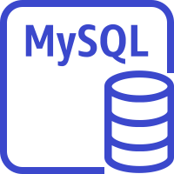
Guided lab: Tasks
Creating an Amazon RDS database
Configuring web application communication with a database instance
Lab VPC
Availability Zone
Public subnet 1
10.0.0.0/24
Private subnet 1
10.0.2.0/23
Application server on EC2 instance
Amazon RDS database instance
Availability Zone
Public subnet 2
Private subnet 2
Notes:
In this guided lab, you will complete the following tasks:
Creating an Amazon RDS database
Configuring web application communication with a database instance

Slide 26


Begin Module 5 – Guided Lab: Creating an Amazon RDS Database
~ 20 minutes
Notes:
It is now time to start the guided lab.

Slide 27
Guided lab debrief: Key takeaways
Notes:
Your educator might choose to lead a conversation about the key takeaways from this guided lab after you have completed it.

Slide 28


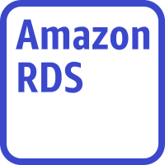

Multi-AZ deployment for high availability
Region
Benefits
Enhanced durability
Increased availability
Fail over to standby occurs automatically
Automated failover conditions
Loss of availability in primary Availability Zone
Loss of network connectivity to primary
Compute unit failure on primary
Storage failure on primary
Availability Zone 1
Availability Zone 2
Routes traffic to the applications
Auto Scaling group
Application instances
Amazon Route 53
Primary
Secondary
Synchronous replication
EBS volume
EBS volume
Notes:
Amazon RDS provides high availability by implementing a Multi-AZ approach. Amazon RDS automatically provisions and maintains a synchronous standby instance in a different Availability Zone. The primary DB instance is synchronously replicated across Availability Zones to the standby instance to provide data redundancy, eliminate I/O freezes, and minimize latency spikes during system backups.
Running a DB instance with high availability can enhance availability during planned system maintenance. It helps protect your databases against DB instance failure and Availability Zone disruption. It also provides enhanced availability and durability for database instances, making it a good choice for production database workloads.
If there is an infrastructure failure, Amazon RDS performs an automatic failover to the standby instance. You can then resume database operations when the failover is complete. The endpoint for your DB instance remains the same after a failover, so your application can resume database operations without manual administrative intervention.
Failover conditions include the loss of availability in the primary Availability Zone, a loss of network connectivity to the primary database, compute unit failure on the primary instance, or storage failure on the primary instance.

Slide 29

Read replicas for performance
Region
Benefits
Enhanced performance
Increased availability
Designed for security
Supported by
MySQL
MariaDB
PostgreSQL
Oracle
Limits
Five read replicas per primary
For strict read-after-write consistency, read from the primary
Availability Zone 1
Public subnet
Application
Read/ write
Private subnet
RDS Read replica
Read
Asynchronous replication
Notes:
Amazon RDS enables you to use a source database instance to create a special type of database instance, which is called a read replica. Updates that are made to the source DB instance are asynchronously copied to the read replica.
Using read replicas enhances performance. For example, you can reduce the load on your source database instance by routing read queries from your applications to the read replica. Read replicas also increase availability. For read-heavy database workloads, you can elastically scale out beyond the capacity constraints of a single database instance. Read replicas can also be manually promoted to become standalone database instances, when needed.
Read replicas are available in Amazon RDS for MySQL, MariaDB, PostgreSQL, and Oracle. Each of these database engines enables up to a maximum of five read replicas per primary database. If you need strict read-after-write consistency (that is, what you read is always what you just wrote, even if you read immediately), then you should read from the main DB instance. Otherwise, you can spread the load, and read from a read replica.

Slide 30

Amazon RDS backup solution
Region
Region
Availability Zone 1
Availability Zone 2
Public subnet 1
Public subnet 2
Application
Primary
Secondary
Private subnet 1
Private subnet 2
Synchronous replication
Snapshots
Transaction logs
Copy snapshots
S3 bucket controlled by Amazon RDS
S3 bucket controlled by Amazon RDS
EBS volume
EBS volume
Notes:
Now, consider an example architecture for a backup solution that is based on Amazon RDS.
Here, snapshots and transaction logs from the RDS database are stored in an S3 bucket that is controlled by Amazon RDS. With Amazon RDS, you can also specify it to copy automated or manual DB to a second AWS Region. You can also copy the snapshots to separate AWS accounts.
For more information, see Copying a Snapshot in the AWS Documentation.

Slide 31
Demonstration: Amazon RDS Automated Backup and Read Replicas
Notes:
Now, the educator might choose to demonstrate the configuration of automated backups and read replicas on Amazon RDS by using the AWS Management Console.

Slide 32
Amazon Aurora
Amazon Aurora is a fully managed, MySQL- and PostgreSQL-compatible, relational database engine.
Used for online transactional processing (OLTP)
Provides up to five times the throughput of MySQL*
Provides up to three times the throughput of PostgreSQL*
Replicates data six ways across three Availability Zones
Requires little change to your existing application
Amazon Aurora
* Benchmarking details are available for MySQL and. PostgreSQL.
Notes:
Amazon Aurora is one of the database engine options for Amazon RDS.
Aurora is a MySQL- and PostgreSQL-compatible relational database that is built for the cloud. It combines the performance and availability of traditional enterprise databases with the simplicity and cost-effectiveness of open source databases.
It is up to five times faster than standard MySQL databases and three times faster than standard PostgreSQL databases. It provides the security, availability, and reliability of commercial databases, but at 1/10th the cost. Detailed instructions on this benchmark and how to replicate it yourself are provided in the Amazon Aurora MySQL Performance Benchmarking GuideMySQL and Amazon Aurora PostgreSQL Performance Benchmarking Guide.
Aurora features a distributed, fault-tolerant, self-healing storage system that automatically scales up to 64 TB per database instance. It delivers high performance and availability, with up to 15 low-latency read replicas, point-in-time recovery, continuous backup to Amazon S3, and replication across three Availability Zones.
Aurora is often used for online transaction processing (OLTP). OLTP systems must be able to handle a high volume of concurrent users, and be able to run insert and update requests. A common OLTP example is an order entry system. OLTP is often contrasted with online analytics processing (OLAP), which is characterized by a smaller volume of more complex queries.

Slide 33
Amazon Redshift
Amazon Redshift is a data warehousing service.
Is used for online analytics processing (OLAP)
Stores very large datasets
Store highly structured, frequently accessed data in Amazon Redshift
Can also store exabytes of structured, semistructured, and unstructured data in Amazon S3
Amazon Redshift
Notes:
Amazon Redshift is a different AWS relational database offering. It does not run on Amazon RDS.
Amazon Redshift provides a petabyte-scale data warehouse and data lake analytics. Amazon Redshift is typically used to store frequently accessed, highly structured data. Amazon Redshift can also access data directly in Amazon S3, so you can also maintain exabytes of structured, semistructured, and unstructured data in Amazon S3.
Amazon Redshift provides consistently fast performance, even with thousands of concurrent queries. It performs consistently whether you are querying data in the Amazon Redshift data warehouse, or querying data in your Amazon S3 data lake. You can query open file formats such as Parquet, JSON, Avro, CSV. You can also query Amazon S3 directly by using SQL.

Slide 34
Section 3 key takeaways
Managed AWS database services handle administration tasks so you can focus on your applications
Amazon RDS supports Microsoft SQL Server, Oracle, MySQL, PostgreSQL, Aurora, and MariaDB
Amazon RDS Multi-AZ deployments provide high availability with automatic failover
You can have up to five read replicas per primary database to improve Amazon RDS performance
Amazon Aurora is a fully managed, MySQL- and PostgreSQL-compatible, relational database engine
Amazon Redshift is a relational database offering for data warehousing
Notes:
Some key takeaways from this section of the module include:
Managed AWS database services handle administration tasks so you can focus on your applications
Amazon RDS supports Microsoft SQL Server, Oracle, MySQL, PostgreSQL, Aurora, and MariaDB
Amazon RDS Multi-AZ deployments provide high availability with automatic failover
You can have up to five read replicas per primary database to improve performance
Amazon Aurora is a fully managed, MySQL- and PostgreSQL-compatible, relational database engine
Amazon Redshift is a data warehousing relational database offering

Slide 35
Section 4: Amazon DynamoDB
Module 5: Adding a Database Layer
Notes:
Introducing Section 4: Amazon DynamoDB.

Slide 36



Amazon DynamoDB
A fully managed non-relational key-value and document database service.
Amazon DynamoDB
X
24/7
Performance at any scale
Serverless
Enterprise-ready
Extreme horizontal scaling capability
Event-driven programming (serverless computing)
Encryption, access controls, backups
Notes:
Amazon DynamoDB is a fully managed non-relational NoSQL database service. It provides fast and predictable performance with seamless scalability.
Key benefits include:
Performance at scale
It offers consistent, single-digit millisecond response times
You can build applications with virtually unlimited throughput
Serverless
No servers to provision, patch, or manage
No software to install, maintain, or operate
Enterprise-ready
It supports ACID transactions
It encrypts all data at rest by default
Multi-Region replication (global tables) is available
It provides fine-grained identity and access control
You can perform full backups of data with no performance impact

Slide 37

Amazon DynamoDB characteristics
Works well for applications that:
Have simple high-volume data (high-TB range)
Must scale quickly
Don't need complex joins
Require ultra-high throughput and low latency
Key features
NoSQL tables
Items can have differing attributes
In-memory caching
Support for peaks of more than 20 million requests per second
Amazon DynamoDB
Notes:
DynamoDB works well for applications that handle a high volume of data and must scale quickly. It also provides ultra-high throughput and low latency, so it is a good option for gaming, adtech, mobile, and other applications that have these requirements. However, a relational database is likely a better choice if your workloads require complex joins.
DynamoDB tables do not have fixed schemas, and each item can have a different number of attributes.
Because DynamoDB provides in-memory caching and can handle more than 20 million requests per second, it is often used for applications that must maintain session state, for serverless web applications, and for microservices.

Slide 38


Amazon DynamoDB data model
Table = Collection of data elements
Data elements stored as attributes
Data partitioned by the partition (hash) key
User
ID
Order
ID
Item = A collection of attributes
Partition1..N
Partition (hash) keys
Sort (range) keys
Notes:
Now, consider the Amazon DynamoDB data model. Unlike relational databases—and because it is a NoSQL database—DynamoDB does not enforce strict schemas.
A DynamoDB table holds items. An item has a variable number of attributes. Each attribute consists of a key-value pair.
DynamoDB supports key-value GET/PUT operations that use a user-defined primary key (partition key, also known as a hash key). The primary key is the only required attribute for items in a table and it uniquely identifies each item. You specify the primary key when you create a table. In addition, DynamoDB provides flexible querying by allowing queries on non-primary key attributes using Global Secondary Indexes and Local Secondary Indexes.
Auto-partitioning occurs when the dataset size grows and as provisioned capacity increases.
Consider an example case where you create an Amazon DynamoDB table to hold order information. In the example, your table entries will always have a User ID and Order ID. However, some of the other details about an order—such as the user's email address—can only be collected for some orders, and not others. As additional items are added to the table, you can continue to collect new attributes. These attributes can include ones that you did not anticipate when you first created the table. This flexibility is what makes DynamoDB a good fit for rapidly changing unstructured, semistructured, and structured data.

Slide 39


Amazon DynamoDB global tables
Global table
Fast local read/write performance for global applications.
Replica
us-west-2
Replica
us-east-1
Replica
eu-central-1
Global tables provide a multi-region, multi-master database.
Notes:
By default, Amazon DynamoDB replicates your data across multiple Availability Zones in a single Region. However, there might be occasions when you want to replicate your data across multiple Regions.
Amazon DynamoDB global tables provide a fully managed solution for deploying a multi-region, multi-master database. You do not need to build and maintain your own replication solution. When you create a global table, you specify the AWS Regions where you want the table to be available. DynamoDB performs all of the necessary tasks to create identical tables in these Regions. DynamoDB then propagates ongoing data changes to all the tables.
To illustrate one use case for a global table, suppose that you have a large customer base spread across three geographic areas—the US east coast, the US west coast, and western Europe. Customers must update their profile information while they use your application.
To handle this business requirement, you could create a global table that consists of your three Region-specific CustomerProfiles tables. DynamoDB would then automatically replicate data changes among those tables. Changes to CustomerProfiles data in one Region would seamlessly propagate to the other Regions. In addition, if one of the AWS Regions became temporarily unavailable, your customers could still access the same CustomerProfiles data in the other Regions.

Slide 40
Amazon DynamoDB use case 1
Leaderboards and Scoring
Players
Game servers
Leaderboard
Notes:
Gaming companies use Amazon DynamoDB in all parts of their game platforms, including game state, player data, session history, and leaderboards. You can scale reliably to millions of concurrent users and requests while you also ensure consistently low latency.
In the example use case, a game score leaderboard is maintained in Amazon DynamoDB. Players who are actively connected to the game servers might see some of this information presented in whatever way the gaming user interface (UI) presents it to them. The GameScores leaderboard is constantly updated when new top scores are achieved and each top scorer's win/loss record changes. As an example, consider Electronic Arts (EA), a large video game company with more than 300 million registered players around the world. For EA, high concurrency can mean more than 100,000 requests per second and millions of daily active users. See DynamoDB Gaming Use Cases for more details.

Slide 41

Amazon DynamoDB use case 2
Temporary Data (Online Cart)
Web store
Shopping cart
Order processing
Users
Notes:
Amazon DynamoDB was developed because customers needed a scalable and highly reliable key-value database to power essential Amazon ecommerce operations, such as the shopping cart.
In 2012, Amazon CTO Werner Vogels explained the business requirements of the Amazon shopping cart in a blog post when he announced the release of Amazon DynamoDB. "This non-relational, or NoSQL, database was targeted at use cases…such as the shopping cart.…Any downtime or performance degradation…has an immediate financial impact and their fault-tolerance and performance requirements for their data systems are very strict. These services also require the ability to scale infrastructure incrementally to accommodate growth in request rates or dataset sizes. Another important requirement…was predictability."
The DynamoDB feature set continues to evolve. However, the core goals that inspired the development of the service remain relevant today to organizations that want to implement a processing solution for a web store shopping cart order.

Slide 42

Amazon DynamoDB consistency options
Eventually consistent
Strongly consistent
Replica
Replica
Replica
Replica
Replica
Replica
The default setting. All copies of data usually reach consistency within 1 second.
This feature is optional. Use for applications that require all reads to return a result that reflects all writes before the read.
Notes:
Read consistency represents how and when the successful write or update of a data item is reflected in a subsequent read operation of that same item. Amazon DynamoDB exposes logic that enables you to specify the consistency characteristics you want for each read request in your application.
Eventually consistent reads
When you read data from a DynamoDB table, the response might not reflect the results of a recently completed write operation. The response might include some stale data. If you repeat your read request after a short time, the response should return the latest data.
Strongly consistent reads
When you request a strongly consistent read, DynamoDB returns a response with the most up-to-date data. The response reflects the updates from all previous write operations that were successful. A strongly consistent read might not be available if there is a network delay or outage.
DynamoDB uses eventually consistent reads, unless you specify otherwise. Read operations (such as GetItem, Query, and Scan) provide a ConsistentRead parameter. If you set this parameter to true, DynamoDB uses strongly consistent reads during the operation.

Slide 43

Class discussion: Which database should the café use?
Amazon
RDS
Amazon DynamoDB
Notes:
Now that you know the essential key features of both Amazon RDS and DynamoDB, consider which of these two database services would be a better match for the café's use case.
In an earlier module in the course, you completed a challenge lab where you deployed a MySQL database that runs on an EC2 instance. This database hosts a table that contains details about the café's menu. It also provides the data storage layer for the orders that customers place online.
If the café team decides that they want to migrate the database layer so they can use an Amazon managed database service, which of these two database options would be a better choice?
The educator will lead your class in a conversation about this topic. You are encouraged to participate in the dialog and explain the reasoning behind your answer.

Slide 44
Section 4 key takeaways
Amazon DynamoDB is a fully managed non-relational key-value and document NoSQL database service.
DynamoDB is serverless, provides extreme horizontal scaling and low latency.
DynamoDB global tables ensure that data is replicated to multiple Regions.
DynamoDB provides eventual consistency by default (in general, it is fully consistent for reads 1 second after the write). Strong consistency is also an option.
Notes:
Some key takeaways from this section of the module include:
Amazon DynamoDB is a fully managed non-relational key-value and document NoSQL database service.
DynamoDB is serverless, provides extreme horizontal scaling and low latency.
DynamoDB global tables ensure that data is replicated to multiple Regions.
DynamoDB provides eventual consistency by default (in general, it is fully consistent for reads 1 second after the write). Strong consistency is also an option.

Slide 45
Section 5: Database security controls
Module 5: Adding a Database Layer
Notes:
Introducing Section 5: Database security controls.

Slide 46

Securing Amazon RDS databases
Recommendations
Run the RDS instance in a virtual private cloud (VPC)
Provides service isolation and IP firewall protection
Use AWS Identity and Access Management (IAM) policies for authentication and access
Permissions determine who is allowed to manage Amazon RDS resources
Use security groups to control what IP addresses or EC2 instances can connect to your databases
By default, network access is disabled
Use Secure Sockets Layer (SSL) for encryption in transit
Use Amazon RDS encryption on DB instances and snapshots to secure data at rest
Use the security features of your DB engine to control who can log in to the databases on a DB instance
Configure event notifications to alert you when important Amazon RDS events occur
Amazon RDS
Notes:
Security is a shared responsibility between you and AWS. AWS is responsible for security of the cloud, which means that AWS protects the infrastructure that runs Amazon RDS. Meanwhile, you are responsible for security in the cloud.
One security recommendation for Amazon RDS is to run your RDS instances in a virtual private cloud (VPC). A VPC enables you to place your instance in a private subnet, which secures it from public routes on the internet. The VPC also provides IP firewall protection and enables you to securely control the applicable network configuration.
In addition, we recommend that you:
Use AWS Identity and Access Management (IAM) policies for authentication and to control access.
Configure security groups to limit connections. Open the TCP port where the database is accessible. However, you limit where those connections can originate from.
Use SSL connections to ensure that all communication to and from your database is secured.
Use Amazon RDS encryption to encrypt your data and database snapshots.
Use the security features of your DB engine, for example, to enforce password complexity.
Enable event notifications on important events that can occur on your RDS instance. These events can include whether the instance was shut down, a backup was started, a failover occurred, the security group was changed, or your storage space is low.

Slide 47
Securing Amazon DynamoDB
Recommendations
Use IAM roles to authenticate access
Use IAM policies
To define fine-grain access permissions to use DynamoDB APIs
Define access at the table, item, or attribute level
Follow the principle of granting least privilege
Configure VPC endpoints
Prevents connection traffic from traversing the open internet
VPC endpoint policies allow you to control and limit API access to a DynamoDB table
Consider client-side encryption
Encrypt data as close as possible to its origin
Amazon DynamoDB
Security provided by default
Encryption at rest of all user data stored in tables, indexes, streams, and backups
Encryption in transit – All communications to and from DynamoDB and other AWS resources use HTTPS
Notes:
To secure Amazon DynamoDB, many of the same best practices that you should use to secure Amazon RDS also apply.
For example, use IAM roles to secure authentication, and use IAM policies to define access permissions.
If you only require access to DynamoDB from within a virtual private cloud (VPC), you should use a VPC endpoint to limit access from only the required VPC. Doing this prevents that traffic from traversing the open internet and being subject to that environment.
Also, If you store sensitive or confidential data in DynamoDB, you might want to encrypt that data as close as possible to its origin so that your data is protected throughout its lifecycle.
Note that DynamoDB provides certain security features by default. For example, DynamoDB protects user data stored at rest and also data in transit between on-premises clients and DynamoDB, and between DynamoDB and other AWS resources within the same AWS Region.
Read the DynamoDB security best practices documentation for additional details.

Slide 48
Section 6: Migrating data into AWS databases
Module 5: Adding a Database Layer
Notes:
Introducing Section 6: Migrating data into AWS databases.

Slide 49


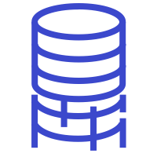
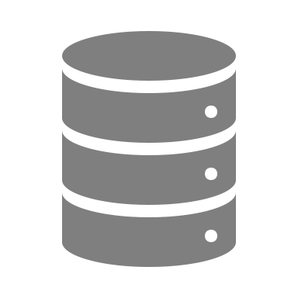
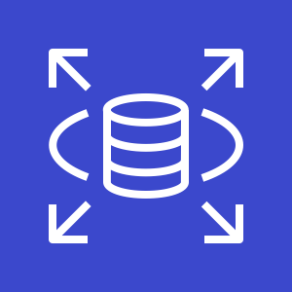

AWS Database Migration Service
Use to migrate to and from most commercial and open source databases
Migrate between databases on Amazon EC2, Amazon RDS, Amazon S3, and on-premises
AWS Database Migration Service (AWS DMS)
Example homogenous migration
SOURCE
TARGET
Oracle database on-premises
AWS DMS job
Amazon RDS for Oracle database
Example heterogeneous migration
MySQL database on EC2 instance
AWS DMS job
Amazon Aurora
Notes:
You can use the AWS Database Migration Service (AWS DMS) to migrate or replicate existing databases to Amazon RDS. AWS DMS supports migration between the most widely used databases.
Supported source databases include Oracle, Microsoft SQL Server, MySQL, MariaDB, PostgreSQL, IBM Db2 LUW, SAP, MongoDB, and Amazon Aurora. Target database engines include Oracle, Microsoft SQL Server, PostgreSQL, MySQL, Amazon Redshift, SAP ASE, Amazon S3, and Amazon DynamoDB.
AWS DMS also supports both homogenous (same engine) migrations and heterogeneous (different engines) migrations.
The first example shown is a homogenous conversion, where an on-premises Oracle database is migrated to Amazon RDS for Oracle database.
The second example shows a heterogeneous migration, where a MySQL database that runs on an Amazon EC2 instance is migrated to Amazon Aurora.

Slide 50

AWS DMS key features
Perform one-time migrations
Or, accomplish continuous data replication
Example: Configure continuous data replication of an on-premises database to an RDS instance
AWS Schema Conversion Tool (AWS SCT) supports changing the database engine between source and target
Typical migration major steps:
Create a target database
Migrate the database schema
Set up the data replication process
Initiate the data transfer, and confirm completion
Switch production to the new database (for one-time migrations)
Notes:
AWS DMS can be used to perform one-time migrations, but it can also be used to accomplish continuous data replication between two databases. For example, you could use it to configure continuous data replication of an on-premises database to an RDS instance.
When you want to perform a heterogeneous migration from one database engine to another, you might want to use the AWS Schema Conversion Tool (AWS SCT).
A typical database migration involves the following major steps:
Create a target database
Migrate the database schema
Set up the data replication process
Initiate the data transfer, and confirm completion
Switch production to the new database (for one-time migrations)

Slide 51



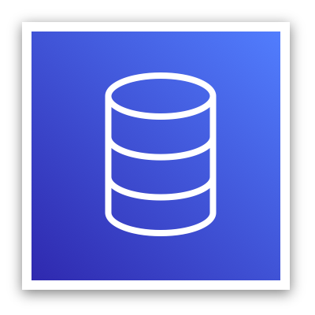
Using AWS Snowball Edge with AWS DMS
When migrating data is not practical:
Database is too large
Connection is too slow
You have privacy and security concerns
Use AWS Snowball Edge
Multi-terabyte transfer without using the internet
AWS Cloud
SOURCE
AWS SCT
Snowball Edge
Shipping process
Snowball Edge
S3 bucket
AWS DMS
TARGET Database
On-premises database
Notes:
Larger data migrations can include many terabytes of information. This process can be difficult because of network bandwidth limits or the amount of data. AWS Database Migration Service (AWS DMS) can use AWS Snowball Edge and Amazon S3 to migrate large databases more quickly than other methods.
AWS Snowball is an AWS service that provides an Edge device that you use to transfer data to the cloud at faster-than-network speeds. An Edge device is an appliance that is owned by AWS. It provides large amounts of on-board storage. The Edge device also uses 256-bit encryption and an open standard Trusted Platform Module (TPM) to ensure both security and full chain of custody for your data.
When you use an Edge device, the data migration process includes the following stages:
Use AWS SCT to extract the data locally and move it to the Edge device
Ship the device back to AWS
After AWS receives your shipment, the device automatically loads its data into an S3 bucket
AWS DMS takes the files and migrates the data to the target data store

Slide 52

Module 5 - Challenge Lab: Migrating a Database to Amazon RDS
Notes:
You will now complete Module 5 – Challenge Lab: Migrating a Database to Amazon RDS.

Slide 53


The business need: A managed database
The database that runs on the EC2 instance is becoming difficult for Sofía and Nikhil to maintain.
When Olivia visited the café recently, she told them about the features of Amazon RDS.
Sofía and Nikhil decided to migrate the café's database to Amazon RDS.
Notes:
The administration of the café database is becoming difficult for Sofía and Nikhil. For example, they must work extra hours when the café is closed to do weekly database backups.
In addition, they recently struggled to install a required patch. Sofía and Nikhil almost did not complete it during the weekend afterhours window. Frank and Martha now realize that these maintenance tasks increase the business' labor costs because they must pay for the overtime hours that Sofía and Nikhil work.
Raquel, an AWS solutions architect, is a café customer and Sofía’s friend. Sofía mentioned the topic of databases to Olivia during a recent conversation. Olivia suggested that they migrate the database to Amazon RDS.
This solution will reduce the burden of manually performing common database maintenance tasks, such as backups, patch installation, and upgrades. As a fully managed service, Amazon RDS performs these tasks automatically.
In this activity, you will take on the roles of Nikhil and Sofía, and work to migrate the café database to Amazon RDS.

Slide 54
Challenge lab: Tasks
Creating an RDS instance
Analyzing the existing café application deployment
Working with the database on the EC2 instance
Working with the RDS database
Importing the data into the RDS database instance
Connecting the café application to the new database
Notes:
In this challenge lab, you will complete the following tasks:
Creating an RDS instance
Analyzing the existing café application deployment
Working with the database on the EC2 instance
Working with the RDS database
Importing the data into the RDS database instance
Connecting the café application to the new database

Slide 55
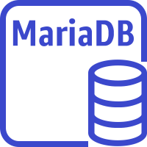




Challenge lab: Final product
AWS Cloud
Region
Availability Zone 1
Availability Zone 2
VPC
Public Subnet
Private Subnet 1
Private Subnet 2
EC2 instance
TCP port 3306
Amazon Linux 2
Apache web server
MariaDB
PHP
Café application
RDS MariaDB instance
IAM Role
Systems Manager Session Manager – terminal in browser access
To EC2 instance
Systems Manager Parameter Store – stores database connection parameters
Notes:
The diagram summarizes what you will have accomplished after you complete the lab.
The café web application originally used the MariaDB that is installed on the EC2 instance. However, in the course of the lab, you create an RDS MariaDB instance, dump the data out of the database on the EC2 instance, and migrate the data into the RDS database.
To accomplish the migration, you connect to the EC2 instance by using the AWS Systems Manager Session Manager, which provides terminal access through a web browser. You use a MySQL client that is installed on the EC2 instance to connect to both databases, as needed, during the migration. Database credentials and database connection information are stored in the AWS Systems Manager Parameter Store. Thus, an IAM role is attached to the EC2 instance to allow the web application to read data out of the Parameter Store.

Slide 56
Begin Module 5 – Challenge Lab: Migrating a Database to Amazon RDS
~ 80 minutes
Notes:
It is now time to start the challenge lab.

Slide 57
Challenge lab debrief: Key takeaways
Notes:
The educator might now choose to lead a conversation about the key takeaways from the challenge lab after you have completed it.

Slide 58
Module wrap-up
Module 5: Adding a Database Layer
Notes:
It’s now time to review the module and wrap up with a knowledge check and discussion of a practice certification exam question.

Slide 59
Module summary
In summary, in this module, you learned how to:
Compare database types
Differentiate between managed versus unmanaged services
Explain when to use Amazon Relational Database Service (Amazon RDS)
Explain when to use Amazon DynamoDB
Describe available database security controls
Describe how to migrate data into Amazon Web Services (AWS) databases
Deploy a database server
Notes:
In summary, in this module, you learned how to:
Compare database types
Differentiate between managed versus unmanaged services
Explain when to use Amazon Relational Database Service (Amazon RDS)
Explain when to use Amazon DynamoDB
Describe available database security controls
Describe how to migrate data into Amazon Web Services (AWS) databases
Deploy a database server

Slide 60
Complete the knowledge check
Notes:
It is now time to complete the knowledge check for this module.

Slide 61
Sample exam question
An application requires a highly available relational database with an initial storage capacity of 8 TB. The database will grow by 8 GB every day. To support expected traffic, at least eight read replicas will be required to handle database reads.
Which option will meet these requirements?
DynamoDB
Amazon S3
Amazon Aurora
Amazon Redshift
Notes:
Look at the answer choices and rule them out based on the keywords that were previously highlighted.
The correct answer is C. Amazon Aurora is a relational database that will automatically scale to accommodate data growth. Amazon Redshift does not support read replicas and will not automatically scale. DynamoDB is a NoSQL service, not a relational database. Amazon S3 is object storage, not a relational database.

Slide 62
Additional resources
AWS Databases – Resource page
Amazon RDS Getting Started Guide
Best Practices for Amazon RDS
Amazon RDS FAQs
Amazon DynamoDB Developer Guide
Amazon DynamoDB FAQs
Notes:
If you want to learn more about the topics covered in this module, you might find the following additional resources helpful:
AWS Databases – Resource page
Amazon RDS Getting Started Guide
Best Practices for Amazon RDS
Amazon RDS FAQs
Amazon DynamoDB Developer Guide
Amazon DynamoDB FAQs

Slide 63
Thank you
Notes:
Thank you for completing this module.

